Slide 1
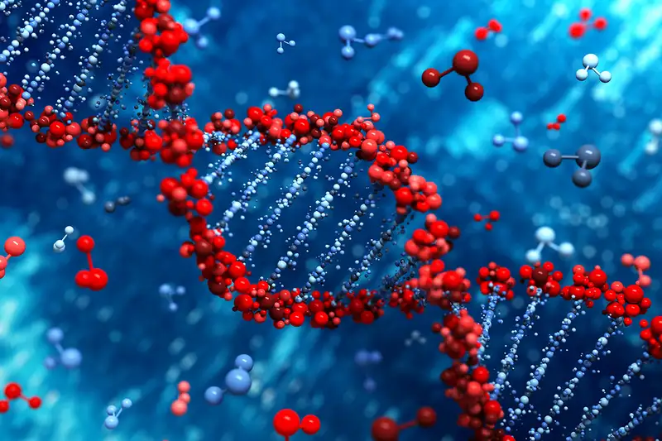
Scoping the Risks of Micro- and Nano-Plastics
Global Health, Human Reproduction and
Possibly Wider Implications*
Ok Pannenborg and Richard Seifman
Greenspring Community, Springfield, VA
Earth Keepers
May 15, 2025
*From: Ok Pannenborg and Richard Seifman, The Plastic Pandemic – Diseases of Unknown Origin, declining Fertility and Wider Implications, Journal of Global, Public and One Health, 2024, November 05, DOI: 10.61034/JGPOH-2024-18, https://jgpoh.com

Slide 2
Diagnostics: Five Main Messages
1. Prevalence of Plastics in environment and biological systems larger than assumed
2. Micro- and Nano-Plastics (MNP*) present in all living organisms (Cf: One Health)
3. Growth of MNP correlates strongly with growth of modern diseases of unknown origin
4. MNP among causes of decline of fertility – correlation with plastics introduction and distribution
5. Life expectancy & QALY reduction worldwide at the end of life in combination with reduction of new life: reduction of global population
NB: Nanoplastics > 1 nm; 1 nanometer, nm = 1 billionth of a meter;
Microplastics < 5mm; 1 micrometer [µm, mu] = 1 millionth of a meter ;
Macroplastics: > 5mm

Slide 3
Addressing the Problem:
Five Approaches for Solutions
1. Material Sciences & Innovation
2. Toxicity Regime & Regulations
3. Multilateral – diplomatics, etc.(Busan, industry)
4. One Health
5. Public Campaigns (Cf: smoking)
N.B. Future of the Human Race (Evolution)

Slide 4
“The intuitive mind is a sacred gift and the rational mind is a faithful servant“ *
Too much plastic
Main objective so far - pollution: land, sea, air
Concerns: micro- & nano-plastics > everywhere + forever
Everywhere: in biology, including humans
So, do they affect our health (*Einstein) ?
R&D: minimal
Plus: fertility
Combine the two: more worrisome
What to do about it: ways and means

Slide 5
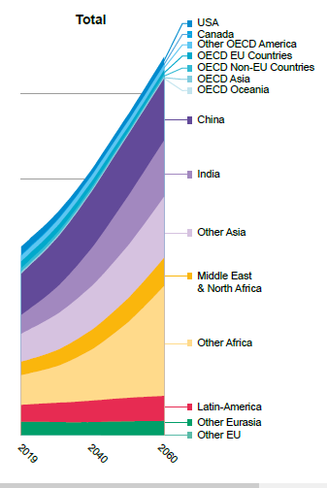
The bulk of macroplastics leakage is projected to come from non-OECD countries, while microplastics leakage will increase everywhere
Source: OECD – Global Plastic Outlook, Policy Scenarios to 2060, Paris 2022

Slide 6
MNP and Health
MNP new variable in etiology and diagnostics
At the same time: hundreds of (new) diseases of “unknown origin”
Examples (out of the 7000+ overall incl. rare and 100+ common): Alzheimer’s, breast cancer, pancreatic cancer (+obesitas), cardiovascular diseases, Parkinson’s
Mechanisms: micro and nano (size + permeability – brain blood barrier + placental barrier)
Effect levels:
    Molecular – (size of nano plastic particles)
    Genetic – chromosomal, protein modification (e.g. carcinogenic)
    Cellular – e.g. mitochondrial
    Metabolic – liver enzymes, spleen, pulmonary changes, intestinal linings and membranes, hematology and vascular dynamics
    Immunological – lymphatic system, B and T cell responses, bone marrow dynamics

Slide 7
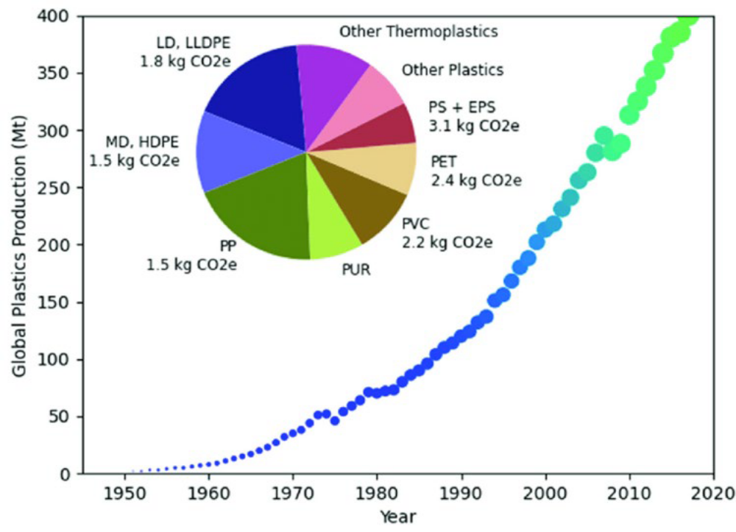
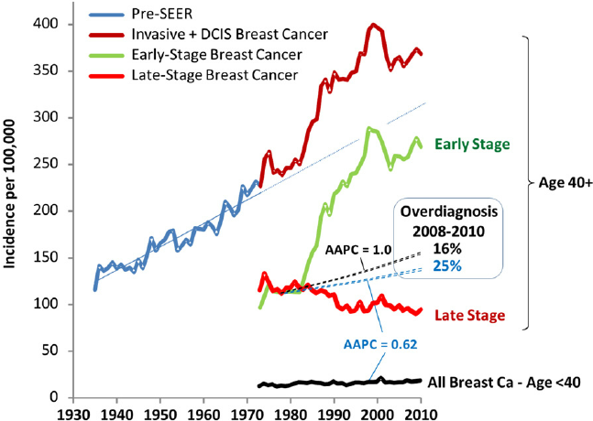
US example: annual breast cancer incidence (Connecticut)
World plastic production throughout the years 1950 - 2019
Source: Bleyer, A., Were Our Estimates of Overdiagnosis With Mammography Screening in the United States "Based on Faulty Science"?, The Oncologist, 19 (2), 2014, 113-126

Slide 8
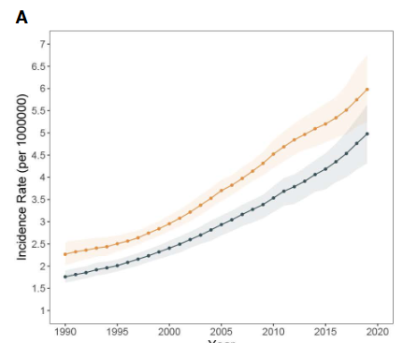
The burden of pancreatic cancer and its temporal trends across Asia
Source: Xiang, X., Chen, X. et al, Pancreatic cancer challenge in 52 Asian countries: age-centric insights and the role of modifiable risk factors (1990-2019), Frontiers in Oncology, Vol 13, 2023, 01 Oct. 2023

Slide 9
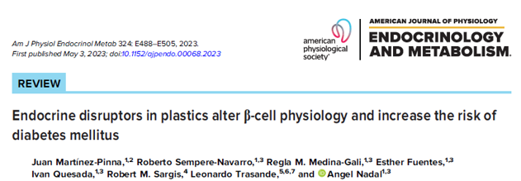
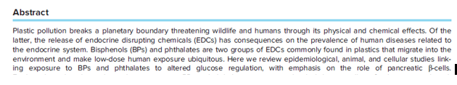



Slide 10
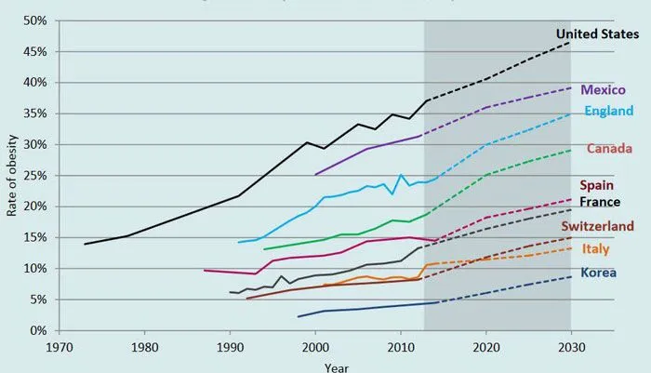
Obesity Rates 1970 - 2020

Slide 11
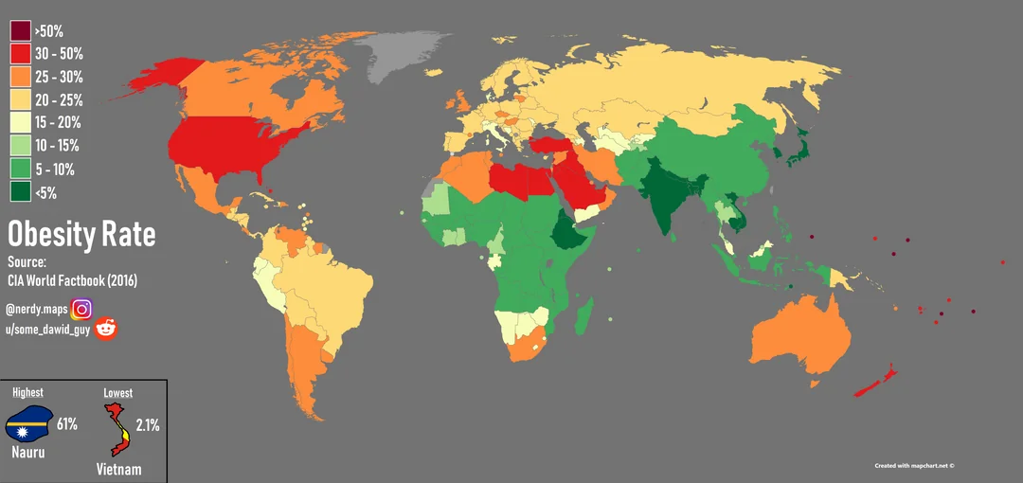
Geographical distribution of MNP and obesity rates (diabetes, pancreatic, adipocytes/infection risks, etc.

Slide 12
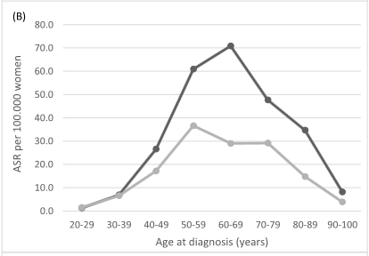
Breast cancer in The Netherlands, age-specific incidence 2012 - 2015
Shifting left to
younger age groups
Source: Dassen, R.R. et al.

Slide 13
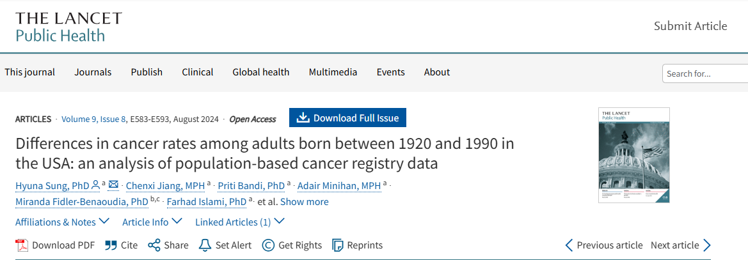
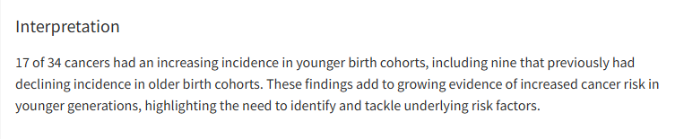
Shifting cancer incidence towards younger generations

Slide 14
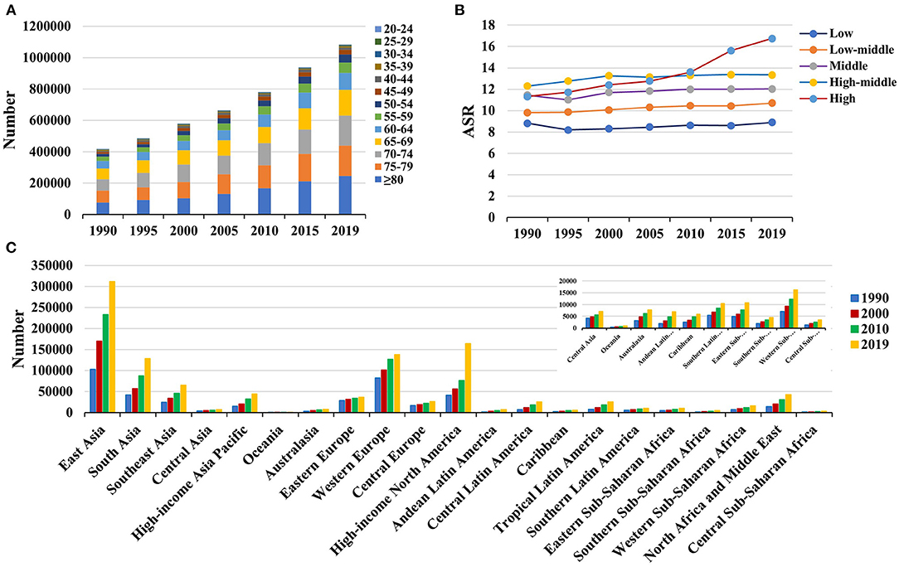
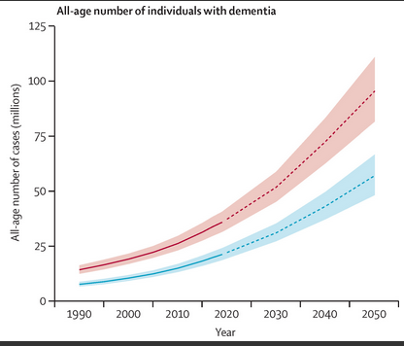
Alzheimer’s & Parkinsons
In 2010 there were +/- 36.5 million people living with dementia; 7.7 million new cases yearly (new case of dementia every 4 sec.) The number of persons with dementia will double every 20 years. Most of these persons will be living in low- and middle-income countries (LMIC).

Slide 15
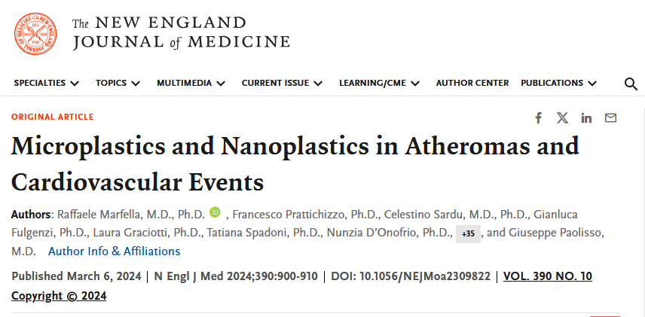
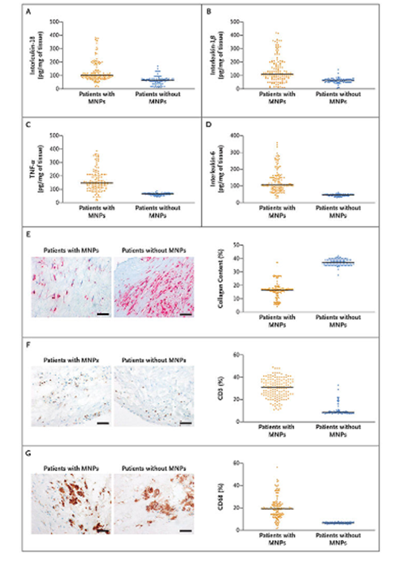
MNP and cardiovascular risks

Slide 16





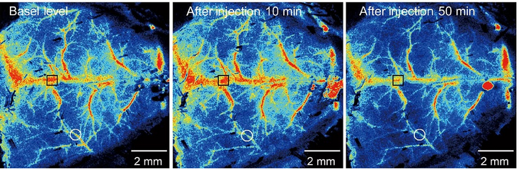
Reduced brain arterial bloodflow from MNP injection as seen below
Source: Topol, E., The Microplastic Concerns Elevate – to the Brain, Ground Truths, Febr. 03 2025

Slide 17
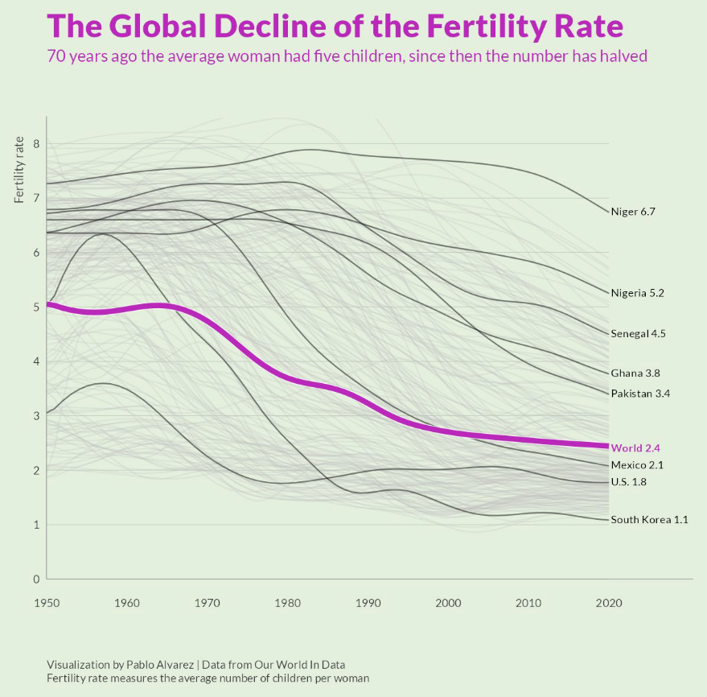
Global MNP and (In)Fertility
Sources: Pires da Mata Costa L, Deborah Vas de Miranda DM, Couto de Oliveira AC et al. Capture
and Reuse of Carbon Dioxide (CO2) for a Plastics Circular Economy: A Review, in Processes, 2021, 9, 75, and
Charted AP. The Global Decline of Fertility Rates, Demographics, June 10, 2022, https://www.visualcapitalist.com/cp/charted-the-global-decline-of-fertility-rates/

Slide 18
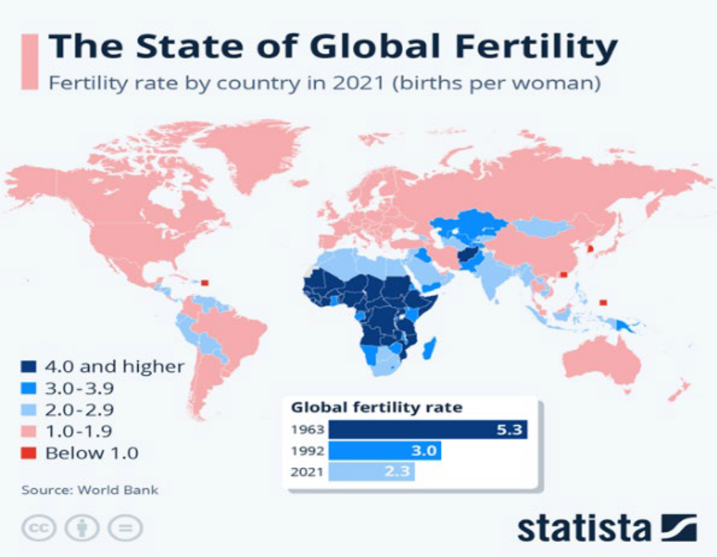
Fertility Decline in Line with Plastics Introduction by Region
Source: Buchholtz K. The State of Global Fertility, Statista, Feb. 28 2024, https://www.statista.com/chart/16058/total-fertility-rate/

Slide 19
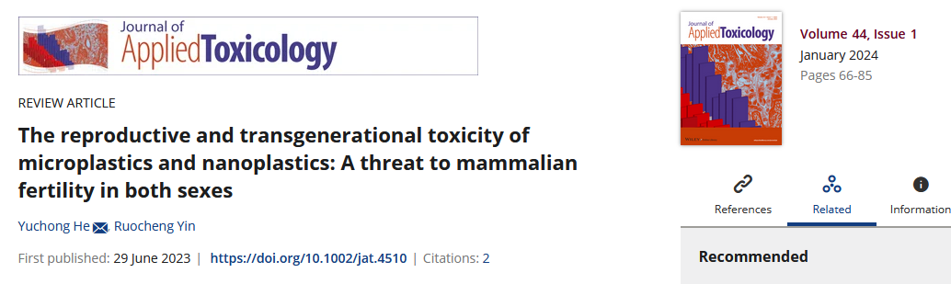
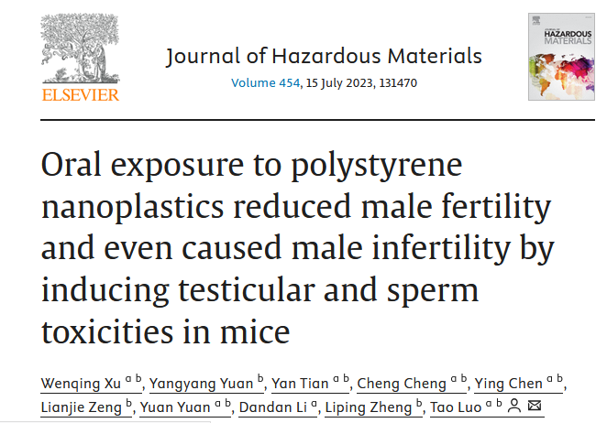
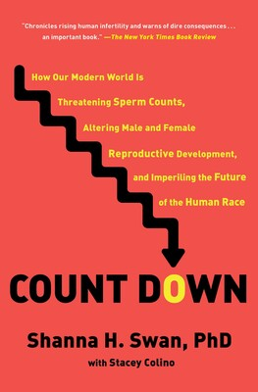



MNP and Infertility Causality
How Our Modern World Is Threatening Sperm Counts, Altering Male and Female Reproductive Development, and Imperiling the Future of the Human Race
By Shanna H. Swan and Stacey Colino

Slide 20
MNP dynamics
rate of elimination < rate of absorption
(hematology)
Accumulation
(immune system: not infection; chronic poisoning)*
* See notes, slide 30
Source: Leslie HA, van Velzen MJM, Brandsma SH, Vethaak AD, Garcia-Vallejo JJ, Lamoree MH. Discovery and quantification of plastic particle pollution in human blood, Environment International, Vol.63., 2022 May 2022

Slide 21
MNP Accumulation
Silent generation (1928 -1945) <<<
Boomers’ generation (1946 -1964) <<
Generation X (1965 – 1980) <
Millennials (1981 -1996) >
Generation Z (1997 – 2012) >>
Generation Alpha (2012 – today) >>>

Slide 22
Joint and mutually Reinforcing Effect:
Δ Diseases of Unknown Origin and MNP-induced Infertility
Global population reduction in the long run (in the short run considered positive)
Severe global economic disruption (most economies shrinking)
Quality-of-life reduction (prevalence shifting downwards, e.g. cancers)
Geopolitical repositioning (US/EU/OECD etc. highest MNP saturation; Africa lowest)

Slide 23
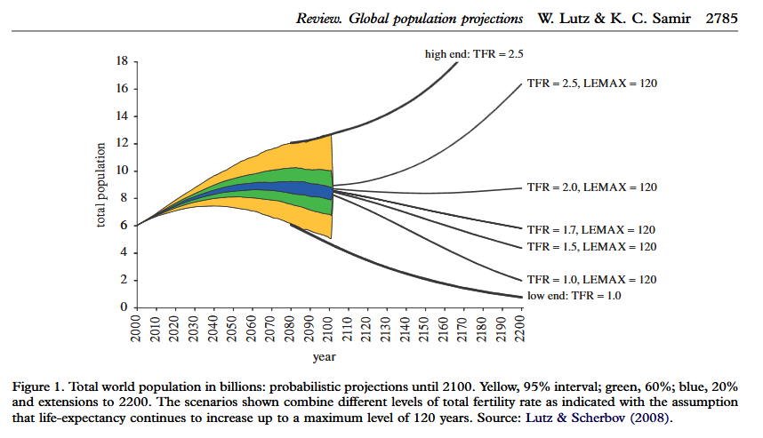
Long-term Scenarios

Slide 24
What to Do
MNP medical R&D re: Evidence (MNP autopsies*, biopsies, etc.)
Reduction (e.g. quatenary filtering of waste water [quatenary ammonium compounds])
Replacement
Material Sciences R&D investments (e.g. RIKEN Labs: ionic monomers X salt-bridges)*
Immunology & biochemistry R&D (structural biology enzymes; MNP vaccines)
Regulation (toxicity assessment system; GRAS** reversal) (e.g. phthalic acid esters)***
Treaties - MNP, One Health, Petrochemical, etc.
Education
* See Eric Topol – MNPs and the Brain (February 03, 2025) ** Generally recognized as safe *** see next slide
Comparators: Climate Change/Global Warming, *Energy

Slide 25

*** Chemical components of plastics
Polymers:
Polyethylene (PE, packaging)
Polypropylene (PP, textiles and other products)
Polyvinyl Chloride (PVC, construction, medical devices, etc.)
Polystyrene (PS, disposable cups, and other products)
Polyethylene Terephthalate (PET, plastic bottles and food packaging)
Polycarbonate (PC, high impact resistance: safety equipment etc.)
Polyurethane (PU, foams, coatings and adhesives)
Monomers:
Ethylene (CH2=CH2): monomer for producing polyethylene
Propylene (CH3-CH=CH2): monomer for producing polypropylene
Vinyl Chloride (CH2=CHCl): monomer for producing polyvinyl chloride
Styrene (C6H5CH=CH2): monomer for producing polystyrene
Additives
Phthalic acid esters (flexers); benzotriazoles (stabilizers); polybrominated diphenyl ethers (flame retardants); etc.

Slide 26

Overview and Looking Forward
International Legally Binding Instrument
on Plastic Pollution, incl. in the Marine Environment
Initiated by UNEP, begun in 2022, its last negotiating session was in December 2024 in Busan, Republic of Korea. Rwanda and Norway led in the creation of a “High Ambition Coalition”.
(Over 3,300 participants, representing governments, academia, civil society organizations, private sector entities, UN entities, and international organizations)

Slide 27
Chairman's last draft related to protect human health:
Treaty objective: greater understanding of health risks of all plastic pollution + recommend reduction measures
Measures: (1) strategies to protect populations at risk
(2) adopt science-based health guidelines relating to the exposure to plastic pollution, in particular microplastics
(3) set targets for (a) exposure reduction, (b) public education, (c) participation of public health and other involved sectors

Slide 28
Negotiations – failed
Self-interest and free market versus global public good
Negotiations failed because there was no agreement on whether the treaty would include mandatory or voluntary measures and whether the measures adopted will apply at the global or national levels. (those opposed--U.S., Russia, Iran, and the Gulf States led by Saudi Arabia )

Slide 29
Options to go forward
As proposed, continuing the current process, now to resume in August in Geneva at the Palais des Nations.
An option to modify the existing approach by considering a phasing approach similar to the 1978 Montreal Protocol on Substances that Deplete the Ozone Layer
If these negotiations failed, the “High Ambition Coalition,” composed of countries that were prepared to sign a mandatory treaty, would initiate an independent process outside the UN.
Increasingly clear collective action is needed but not easy

Slide 30
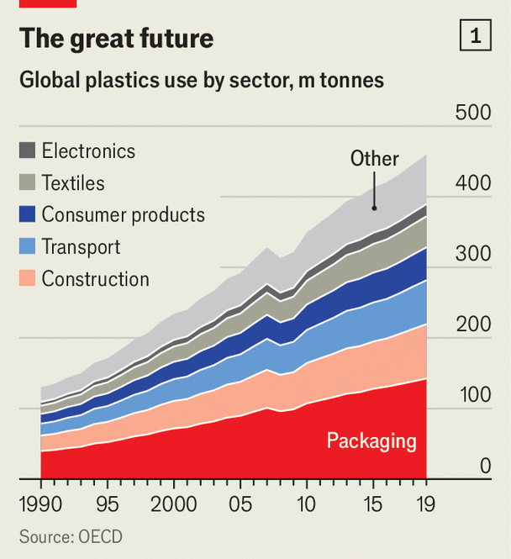
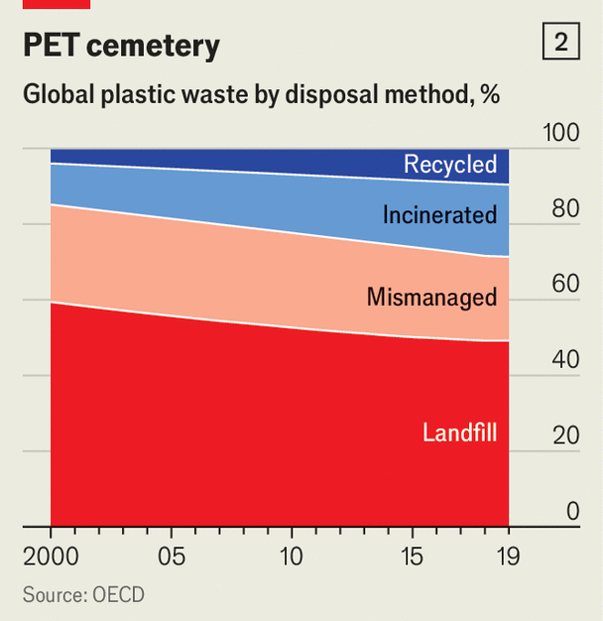
Part of the Problem: Powerful Proponents of Plastics -“plastics are beautiful” a
Supply: chemical industry, finance & investment, et al. Demand: you and me
PET: Polyethylene Terephthalate
Source: The Economist, April 16, 2025, US Edition (incl. Don’t overlook the many benefits of plastics)

Slide 31
Plastics Links with One Health (1)
1. Interconnectedness: One Health emphasizes the shared risks and benefits
across human, animal, plant and environmental health - MNP moves across all
four
2. Collaborative Approach: It requires cooperation and communication
among various disciplines, including medicine, veterinary science, biology and
environmental science - MNP prevalence in each field increasing
3. Disease Prevention: One Health focuses on disease outbreaks by clarifying
the underlying factors leading to their emergence – MNP new cause
4. Zoonotic Diseases: It addresses zoonotic diseases: diseases that can spread
from animals to humans – MNP now from humans to animals, plants, etc.
5. Antimicrobial Resistance: One Health tackles antimicrobial resistance, a
growing threat that impacts human and animal health – MNP now major
factor in AMR

Slide 32
Plastics Links with One Health (2)
6. Food Safety: It promotes safe food systems by considering the health of
animals and the environment involved in food production – much of it more
and more MNP infested
7. Environmental Health: One Health acknowledges the importance of a
healthy environment for human and animal health, including the impact of
climate change and pollution – MNP “pollution”
8. Ecosystem Health: It recognizes that healthy ecosystems are essential for
overall health and well-being, including the health of humans and animals and
plants--MNP in ocean life, animals, plants and trees (e.g. soil
vectors ); unknown long-term effects

Slide 33
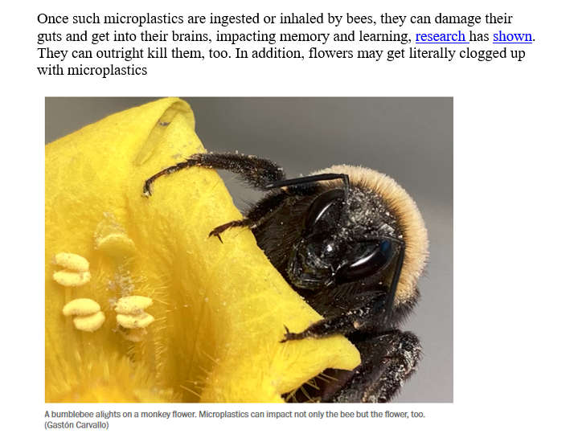
Example of plant /animal contamination with consequences
See: Seifman, Richard, Bee Populations Are Declining Faster Than Ever Before - They are important One Health champions, Impakter, April 01, 2025

Slide 34
Plastics and One Health (3)
9. Global Health Security: One Health plays a crucial role in
strengthening global health security by addressing shared health
threats one of which is increasingly clear includes MNPs
10. Sustainable Solutions: It aims for sustainable solutions that benefit
all three aspects of One Health - human, animal, and environmental
- MNP is a new agenda for One Health – urgently needed
Examples: www.algenesislabs.com (Soleic) and other biomaterials
(e.g. Bloom Biorenewables, DSM-Firmenich, Tidal Vision, Pulpex,
Danimer, GF Biochemicals, Synonym, Hyosung (sugarcane),
L’Oreal (95% bio-based 2030), etc.

Slide 35
Prospects: Not bright short-term, but better in the longer-term
Government responses: recent French and EU MNP restrictions; California MNP restrictions (+ tax and incentive policies; waste policies)
Private Sector: engagement + lip service reversal; product redesign; trade competition between alternatives and substitutes (cf. global renewable energy competition now as compared with 25 years ago)
Research: public & private funding: material sciences + substitution option
Community: awareness campaigns (cf. smoking 1980s campaign); law suits
Courts (incl. international law): proceedings of claims regarding environment and health damage and wrongdoing resulting from MNP production and distribution while knowingly causing harm (class action suits and similar)(22)

Slide 36

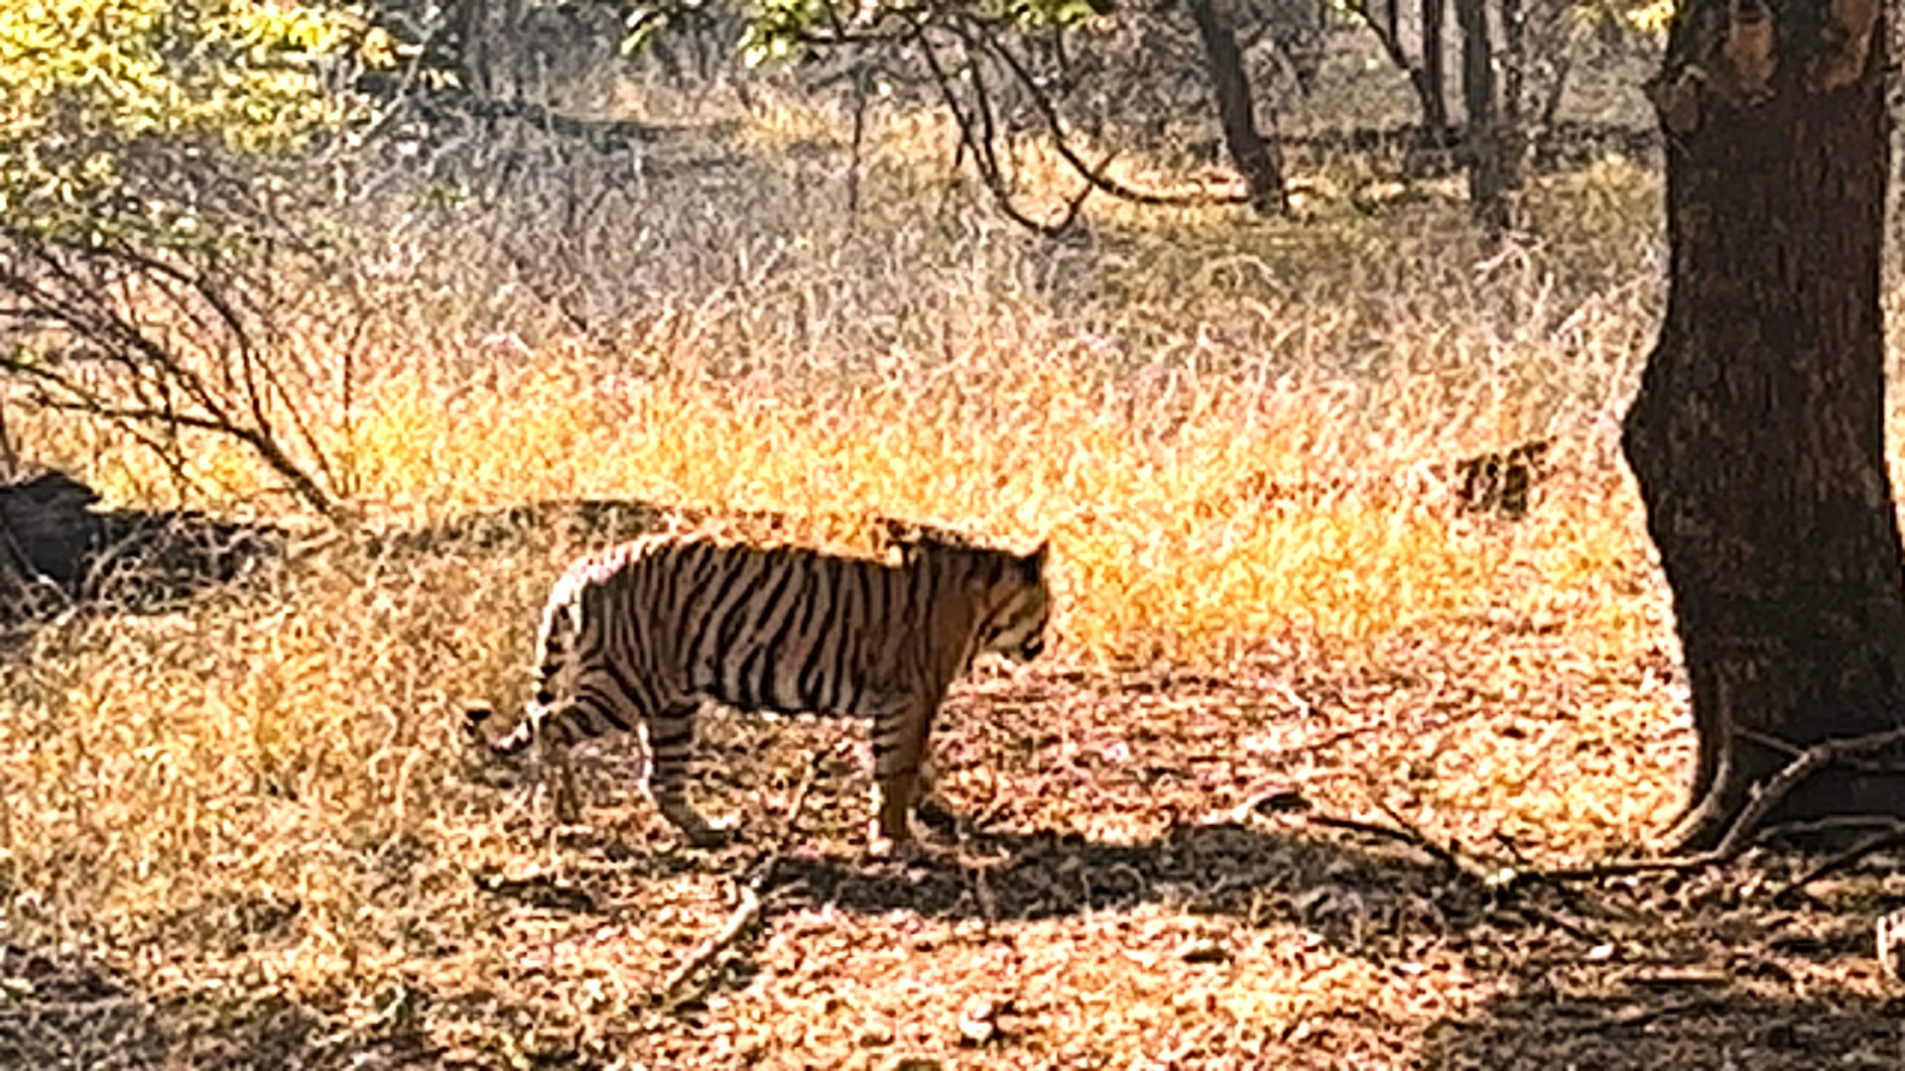
Remaining hopeful
Pictures taken by Richard Seifman, 02 March 2025

Slide 37
Attachments and References

Slide 38
Explanatory Note – MNPs and the immune system (20)
The immune system can react to microplastics, but often does so weakly due to their unique small size, inert nature, and lack of recognizable molecular patterns, making it difficult for immune cells to identify and target them, leading to a muted response. MNPs can disrupt immune function through the extracellular matrix and hindering signaling pathways, causing inflammation and disabling immune cells.
Key points about MNPs and the immune system:
Difficult to recognize: unlike bacteria or viruses, microplastics lack the necessary molecular markers that trigger an immune response from immune cells like macrophages.
Size and shape: the small size of microplastics prevents efficient phagocytosis (engulfing) by immune cells, limiting their ability to clear them from the body.
Accumulation in tissues: MNPs can accumulate in tissue. including the lungs and digestive tract, where they may disrupt cellular function and can interfere with immune responses.
Potential for inflammation: some studies suggest that MNPs may trigger low-grade inflammatory responses due to their presence and interaction with immune cells.
Impact on immune cell function: MNPs can disrupt the signaling pathways within immune cells, potentially impairing their ability to respond effectively to pathogens.

Slide 39
References (1)
, , , , , ,
, , , , , ,
R.R.E. Dassen, S. Pelders, et al.,, The effect of attendance in the Dutch breast cancer screening program on breast tumor characteristics among migrant women, The Breast, Volume 69, June 2023, pages 290 – 298 (slide 12)
Michael Marshall, Biochemistry – the Study of the chemicals that make up life, New Scientist, 31 Jan 2025, https://www.newscientist.com/definition/biochemistry/ (icon on upper left corner of each slide)
Eric Topol, The Microplastics Concerns Elevate – to the Brain, Ground Truths, 03 Febr 2025
OECD – Global Plastic Outlook, Policy Scenarios to 2060, Paris 2022
Bleyer, A., Were Our Estimates of Overdiagnosis With Mammography Screening in the United States "Based on Faulty Science"?, The Oncologist, 19 (2), 2014, 113-126
Xiang, X., Chen, X. et al, Pancreatic cancer challenge in 52 Asian countries: age-centric insights and the role of modifiable risk factors (1990-2019), Frontiers in Oncology, Vol 13, 2023, 01 Oct. 2023
Martinez-Pinna, J., et al, Endocrine Disruptors in Plastics Alter β-cell Physiology and Increase the Risk of Diabetes Mellitus, American Journal of Physiology, Endocrinology and Metabolism, 324, 3 May 2023, 488-505
Hyung Sung, et al., Differences in cancer rates among adults born between 1920 and 1990 in the USA: an analysis of population-based cancer registry data, The Lancet Public Health, Vol.9, Issue 8, August 2024, p. e583-e593
Raffaele Marfella, et al., Microplastics and Nanoplastics in Atheromas and Cardiovascular Events, New England Journal of Medicine, March 06, 2024, Vol. 390, p.900-910
Pires da Mata Costa L, Deborah Vas de Miranda DM, Couto de Oliveira AC et al. Capture and Reuse of Carbon Dioxide (CO2) for a Plastics Circular Economy: A Review, in Processes, 2021, 9, 75, and Charted AP.
The Global Decline of Fertility Rates, Demographics, June 10, 2022, https://www.visualcapitalist.com/cp/charted-the-global-decline-of-fertility-rates/

Slide 40
References, continued (2)
12. Buchholtz K. The State of Global Fertility, Statista, Feb. 28 2024, https://www.statista.com/chart/16058/total-fertility-rate/
13. Wengquing Xu, et al, Oral exposure to Polystyrene Nanoplastics reduced male fertility and even caused male infertility by inducing testicular and sperm toxicities in mice, Journal of Hazardous Materials, Vol 454, 15 Juli 2023
14. Yuchong He, et al., The Reproductive and Transgenerational Toxicity of Microplastics and Nanoplastics: A Threat to Mammalian fertility in Both Sexes, Journal of Applied Toxicology, Vol.44, Issue 1, pages 66-85
15. Shanna H. Swan and Stacey Colino, Count Down: How Our Modern World Is Threatening Sperm Counts, Altering Male and Female Reproductive Development, and Imperiling the Future of the Human Race, Scribner, 23 Februari 2021
16. Leslie HA, van Velzen MJM, Brandsma SH, Vethaak AD, Garcia-Vallejo JJ, Lamoree MH. Discovery and quantification of plastic particle pollution in human blood, Environment International, Vol.63., 2022 May 2022
17. Lutz W, Sanderson W, Scherbov S. The coming acceleration of global population ageing. Nature. 2008 Feb 7;451(7179):716-9
18. Yuxuan Wang, Jingfeng Gao, et al., Unignorable environmental risks: Insight into differential responses between biofilm and plastisphere in sulfur autotrophic denitrification system upon exposure to quaternary ammonium compounds, Journal of Hazardous Materials, Vol. 487, 2025, 137231, SSN 0304-3894, https://doi.org/10.1016/j.jhazmat.2025.137231
19. Yiren Cheng, Eiji Hirano, et al., Mechanically strong yet metabolizable supramolecular plastics by desalting upon phase separation, Science, 21 Nov 2024, Vol 386, Issue 6724, pp. 875-881, DOI: 10.1126/science.ado1782
20. Yang W, Jannatun N, Zeng Y, Liu T, Zhang G, Chen C, Li Y. Impacts of microplastics on immunity. Frontiers of Toxicology, 2022 Sep 27;4:956885. doi: 10.3389/ftox.2022.956885. PMID: 36238600; PMCID: PMC9552327.
21. Seifman, Richard, Bee Populations Are Declining Faster Than Ever Before - They are important One Health champions, Impakter, April 01, 2025 https://impakter.com/bee-populations-are-declining-faster-than-ever-before/

Slide 41
References, continued (3)
22. For a recent example of a class action suit, see: Ziplocks: https://www.yahoo.com/news/popular-kitchen-brand-accused-deceptive-202053687.html
All other references listed in Pannenborg, O. and Seifman, R., The Plastic Pandemic – Diseases of Unknown Origin, declining Fertility and Wider Implications, Journal of Global, Public and One Health, 2024, November 05, DOI: 10.61034/JGPOH-2024-18, https://jgpoh.com

Slide 42
Additional material for discussions and illustrations
Ziplocks: https://www.yahoo.com/news/popular-kitchen-brand-accused-deceptive-202053687.html

