Slide 1
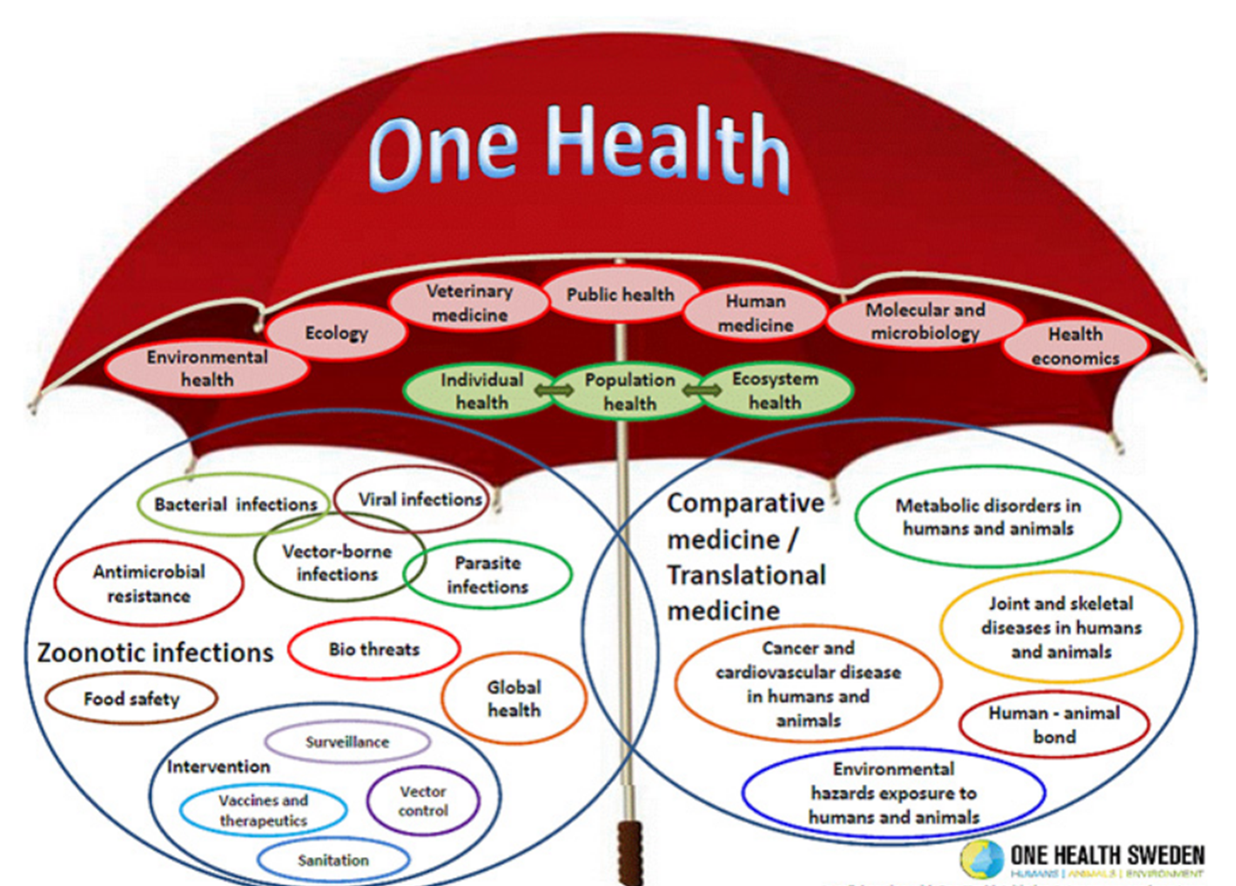
The Emerging Concept of One Health The Interface of Animal, Human and Environmental Health
Craig N Carter, DVM MS PhD
Professor, Epidemiology
College of Agriculture, Food & the Environment
Adjunct Professor, College of Public Health
University of Kentucky
Adjunct Professor, College of Veterinary Medicine
Lincoln Memorial University
University of Kentucky
Many thanks to:
Samuel Matheny, MD MPH
Assistant Provost for Global Health Initiatives
Professor of Family and Community Medicine
University of Kentucky
Terry Lennie, MS PhD
Senior Executive Dean
UK College of Nursing
Bruce Kaplan DVM Dipl. AVES
One Health Initiative
Lonnie King DVM MS MPA
Dean, The Ohio State University CVM (Ret.)

Slide 2

What is One Health?
From the One Health Initiative Website
https://onehealthinitiative.com/

Slide 3
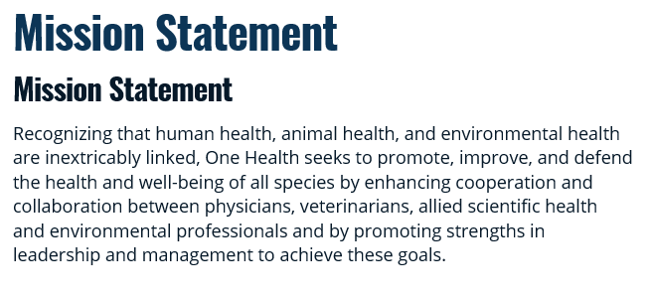
One Health Mission Statement?
From the One Health Initiative Website
https://onehealthinitiative.com/

Slide 4
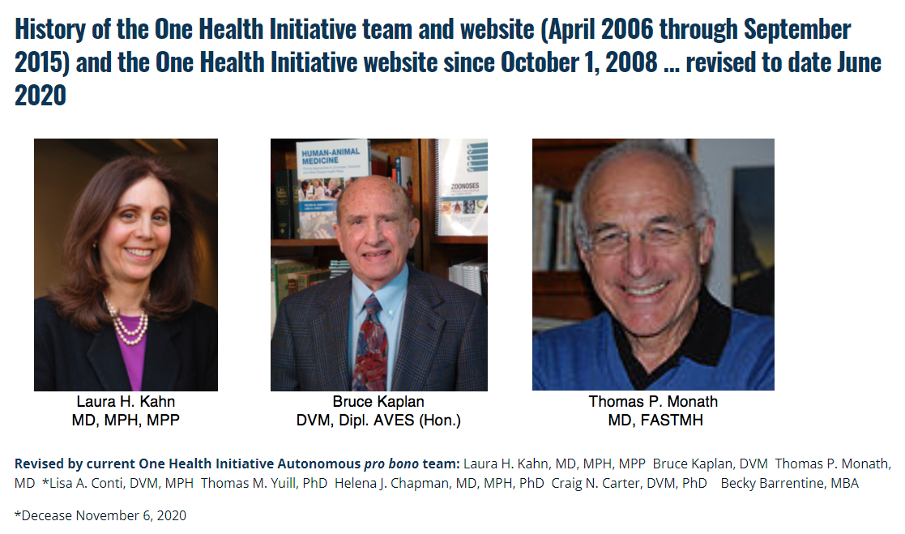
One Health Initiative Leadership
From the One Health Initiative Website
https://onehealthinitiative.com/
Notes:
Laura Kahn, MD – Research Scholar with the program on Science and Global Security until 2021 at Princeton, co-founder of the OHI, prolific writer and author of books on One Health and beyond.
Bruce Kaplan, DVM – Career with CDC as an epidemiologist and co-founder of the OHI
Thomas Monath, MD – Management partner of Crozet Biopharma, developer of Ebola vaccines, Professor, Harvard School of Public Health

Slide 5
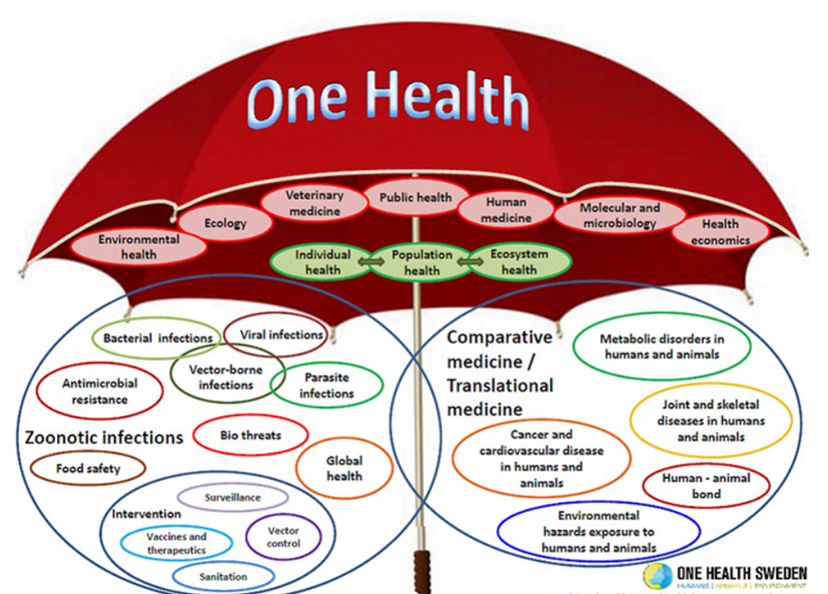
One Health Initiative Facts
From the One Health Initiative Website
https://onehealthinitiative.com/
Over 30,000 web site visits per month from over 160 countries.
Co-founders, Pro Bono Team, and 40 experts on Advisory Board field (including a Nobel Laureate) respond to global inquiries daily.
1100+ medical associations, organizations, universities, state & federal agencies, and leaders/supporters.

Slide 6

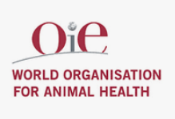

Major Organizations Fully Embracing
One Health
From the One Health Initiative Website
https://onehealthinitiative.com/
World Health Organization (WHO)
World Organization for Animal Health (WOAH)
Food & Agricultural Organization (FAO)

Slide 7
What is a zoonotic disease?
Zoonotic diseases (also known as zoonoses) are caused by bacteria, viruses, fungi, parasites et al that spread between animals and people.
How transmitted?
  Direct contact with body fluids of an infected animal
  Indirect contact, areas where animals live, objects or surfaces that are contaminated
  Vector-borne – insect bite
  Foodborne – eating contaminated food
  Waterborne – drinking contaminated water
60% of all major infectious diseases (~270) are zoonotic (~160)
75% of new/emerging diseases arise from animals

Slide 8
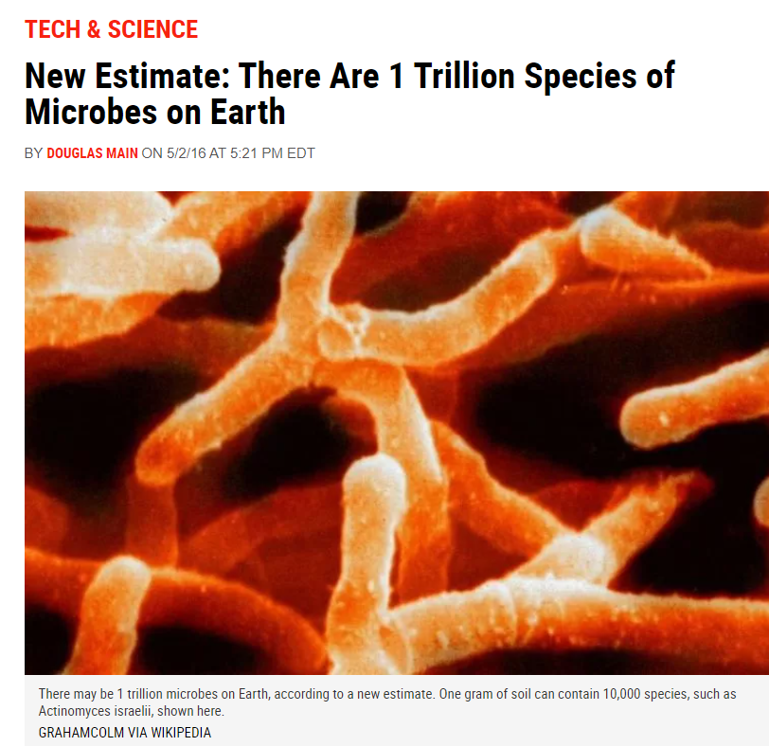
Notes:
We scarcely know the life that exists on this planet. A new estimate suggests that there are 1 trillion species of microbes on Earth,
and humans have only described less than one-thousandth of 1 percent of these (0.001 percent).

Slide 9
Classification of zoonotic diseases
Anthropozoonosis – Animal to human (e.g. rabies)
Zooanthroponosis – Human to animal (amebiasis, COVID-19)
Amphixenosis – Maintained in both animals and humans and can be transmitted in either direction (e.g. staph or strep infection)
Metazoonosis – Both vertebrate and invertebrate species involved (e.g. plague)

Slide 10
Some facts regarding the causal agents…
Smallpox
Only one has been eradicated
At least one could become very lethal again
Some are vectorborne
Some have no treatments
Some have no vaccine
Two of these diseases now still causing almost 1M deaths annually
Most have been around for millennia
Influenza
Malaria
Influenza
Malaria
Malaria+Influenza

Slide 11
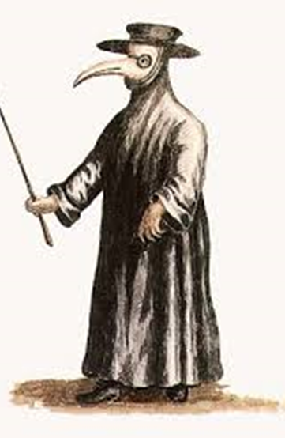
Major Human Epidemics
Plague (Black Death)
  Yersinia pestis – a zoonotic pathogen (metazoonosis)
  1331 – 1770, Europe
  Still endemic in the USA
  Flea transmission, rats to humans
  50 million people died in Europe (60% of population from 1347-1352)
  Bubonic form – 50-60% CFR
  Pneumonic/septicemic form – almost 100% CFR

Slide 12
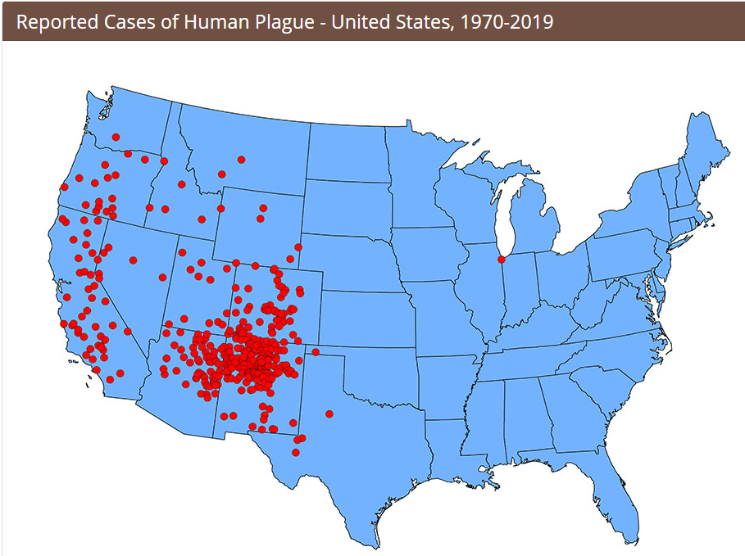

Slide 13
Major Human Epidemics
Smallpox (Variola minor, Variola major viruses)
Orthopox virus
Not a zoonotic agent, however monkeypox is!
Earliest evidence, 3rd century BC
18th century Europe, 400,000 deaths annually
20th century estimates, 500 million deaths
In 1967, 15 million cases/year
Variola major 20-50% mortality
Last naturally occurring case, 1977
WHO announced global eradication, 1980

Slide 14
Major Human Epidemics
Influenza – Spanish Flu 1918-1919
Unusually deadly influenza epidemic, strain H1N1
Type A virus, aquatic birds
Infected 500 million people across the globe
Estimated 100 million deaths this epidemic
Mortality, 10-20% of those infected
In the early 20th century, life expectancy dropped by 12 years
Severe respiratory disease
High mortality in healthy young adults
Current annual endemic influenza 3-5 million cases and 250-500K deaths annually worldwide

Slide 15
Major Human Epidemics
Malaria (Italian for “bad air”)
Mosquito-borne infectious disease
Single celled Plasmodium microorganisms
Not a zoonosis
Tropics/subtropics near the equator
Likely in existence for about 100,000 years.
Estimated over 800,000 deaths annually worldwide
IP 10-15 days after mosquito bite
Still no vaccine, promising work ongoing
Flu-like symptoms, very high fever, various syndromes

Slide 16
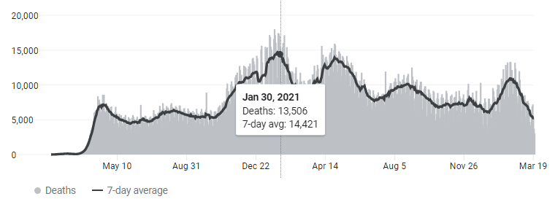
Major Human Epidemics
COVID-19
First cases Wuhan, China December 2019
Etiology SARS-CoV-2 (Severe acute respiratory syndrome coronavirus 2)
Amphizenosis? Definitely an anthropozoonosis
As of March 28, 2022
    ~481 million cases worldwide
    6.1M+ million deaths 2020-present
  Transmission person-to-person via respiratory droplets
  Symptoms flu-like, respiratory, low blood oxygen, multi-systemic

Slide 17
Other Notable Human Epidemics
Epi. Typhus - Rickettsia prowazekii – (zoonosis) (anthropozoonosis) 18th century millions of deaths, now rare, rat fleas, no vaccine.
Cholera - Vibrio cholerae - (no animal hosts) Early 19th century to present, most deadly disease of the 19th century, fecal to oral.
Polio – Enterovirus - (a human pathogen only) 14th century till present, up to 15-30% fatality, fecal to oral.
HIV/AIDS - Lentivirus - 1981–present (Simian ancestry but not considered a zoonosis) ~1M die each year
Ebola - Ebolavirus – (emerging zoonosis primates) 1976-present, 11K die each year

Slide 18
Antimicrobial Resistance?
Tuberculosis - Estimated 480,000+ cases of multi-drug resistance worldwide
Malaria - Multi-drug resistance in falciparum malaria in Southeast Asia
HIV - Anti-viral therapy (AVT) drug resistant HIV 7% in developing countries and as high as 20% in developed countries—as high as 40% in patients restarting treatment
Influenza - Antiviral drugs (AVT) used in epidemic and pandemic outbreaks. Amantadine & Rimantadine---resistance 1-2% and increasing).

Slide 19
2016 Wellcome Trust Report
The Wellcome Trust is a charitable foundation focused on health research based in London in the United Kingdom, founded in 1936
Alarming AMR findings in 2016 Wellcome Trust Report.
Superbugs will soon kill more humans than cancer.
Currently 700,000 annual deaths per year related to AMR.
Predicted to grow to 10 million deaths per year by 2050 with a price tag of $100 Trillion USD of lost human productivity.
AMR may become the most important One Health Challenge for the next 3-4 decades.
Notes:
The Wellcome Trust is a charitable foundation focused on health research based in London in the United Kingdom., founded in 1936

Slide 20
Epidemiologic Transitions –
Last 35 years
Emerging infectious diseases globally
New diseases and increases in mortality; first since 19th century
Antimicrobial resistance
60% of all human pathogens are zoonotic
75% of emerging diseases are zoonotic
The microbial “perfect storm” is brewing

Slide 21
Recent Epidemics over
the last 30 years
1993 – Hanta virus (Sin Nombre, USA)
1994 – Plague (India)
1994 - Ebola virus (Zaire)
1996 – UK Variant of CJD
1996 - H5N1 influenza (Hong Kong)
1998 – Nipah virus (Malaysia)
1999 – West Nile (New York)
2000 – Rift Valley fever (Saudi Arabia)
2001-2002 – Anthrax (by mail USA)02 – Nor
2003 – SARS (Hong Kong)
2004 – Marburg Virus (Angola)
2005 – H₅N₁ Influenza (China)
2006 – E. coli (spinach, USA)
2007 – Prog Inflammatory Neuropathy (swine slaughterhouse workers, USA)
2008 – Salmonella St Paul (produce, USA)
2009 – H1N1 Influenza (Pandemic)
2010 – Cryptococcus (NW USA)
2014-2016 Ebola (West Africa)
2014 – MERS (Saudi Arabia)
2017 – Salmonella (turtles, USA
2018 – Salmonella (poultry, USA)
2020 – COVID-19 Pandemic

Slide 22
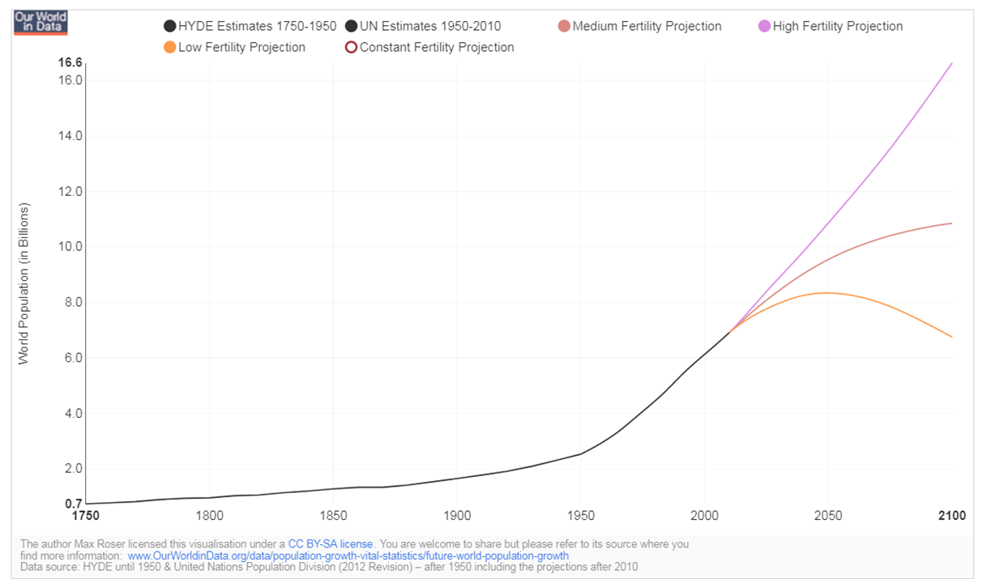
Forecast of World Population Growth

Slide 23
Environmental factors
Shift of populations to urban areas.
  Bringing animal pathogens closer to humans.
  International tourism.
  Increasingly toxic environment
    Air, water, soil
  Deforestation
  Climate change
7 billion population unprecedented
Importance of ecosystems and environment
All are key ingredients for major epidemics.

Slide 24
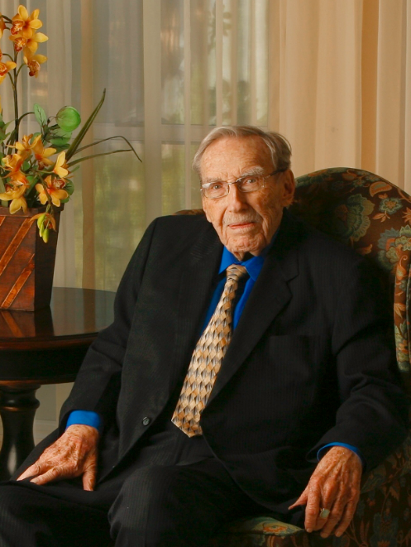
James H. Steele, DVM MPH
Father of Veterinary Public Health, 1913-2013
“Good animal health is necessary to achieve optimal human health.”
“Good human health is necessary to achieve optimal animal health.”

Slide 25
One Health Success Stories
1989
First flexible coil balloon Expandable Intracoronary Stent development for Humans (physician and veterinarian), pig animal model, (U of AL)
2009
Orthopedic surgeons (physician and veterinarian) research hip and knee replacement methods on dogs as a model for humans, U of Missouri
2011
Veterinarians and physicians prove that Helicobacter pylori leads to gastric cancer, mouse model, MIT
2020
Human medical labs unable to handle COVID testing demand at the start of the COVID-19 pandemic
Veterinary network labs obtain CLIA certification and run millions of PCRs to assist with surge testing

Slide 26
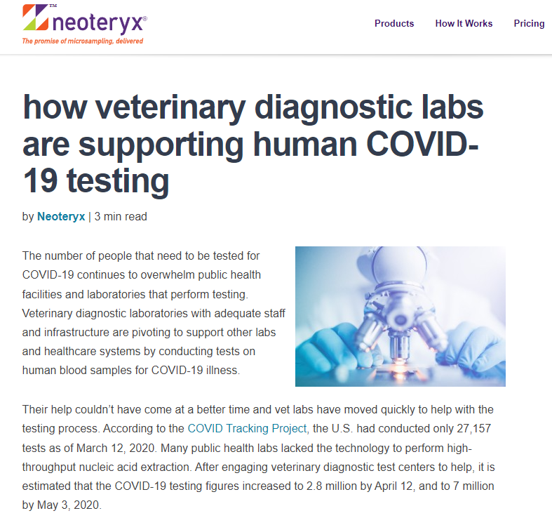

Slide 27
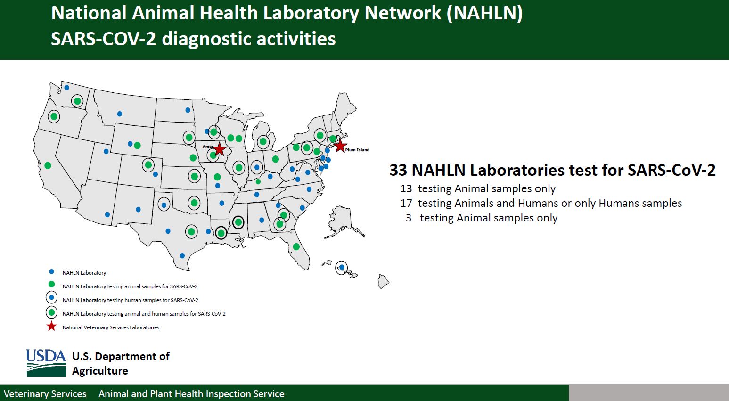

Slide 28
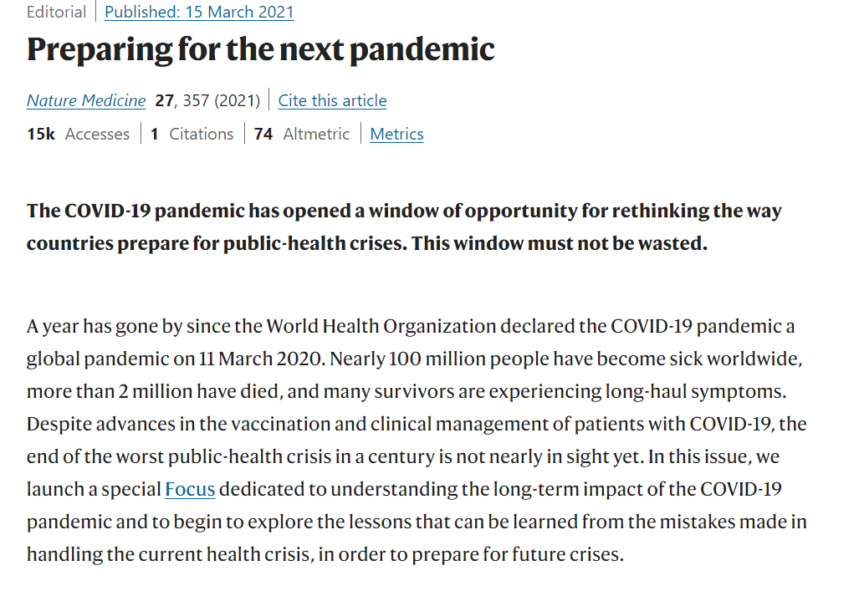

Slide 29


Slide 30

One Health Discussion Topics

Slide 31
One Health Discussion Topics
Historic inspirations for advancing OH
https://onehealthinitiative.com/a-perspective-some-significant-historic-inspirations-for-advancing-the-one-medicine-one-health-concept-movement-19th-20th-and-21st-centuries/
One Health: An historic perspective
https://onehealthinitiative.com/wp-content/uploads/2021/02/One-Medicine-One-Health-An-Historic-Perspective-FEB1-2021-1.pdf
What is One Health?
https://www.forbes.com/sites/johndrake/2020/10/31/what-is-one-health/?sh=7f8c8e36134c
Health Illiteracy – Why a silent epidemic needs a “One Health” approach
https://impakter.com/health-illiteracy-one-health-approach/
One Health Needs Global Recognition: A Call for Superstars to Come Forward
https://impakter.com/one-health-recognition-superstars/

Slide 32
One Health Discussion Topics
One Health, one cure – The history of the approach to health that promises to prevent future pandemics
https://news.globallandscapesforum.org/47955/one-health-one-cure/
Brain Health, One Health, and COVID-19
https://www.karger.com/Article/FullText/519372
G20 Takes the Next Step in Making One Health a Priority
https://impakter.com/g20-step-one-health-priority/
The One Health Act of 2019 & 2021
https://www.smith.senate.gov/us-sens-smith-young-renew-bipartisan-push-improve-public-health-preparedness-coordinated-one-health
https://dustyjohnson.house.gov/media/press-releases/johnson-schrader-push-improve-public-health-preparedness-coordinated-one-health
https://docs.google.com/document/d/1smfrAkuHWgVBMLMyOpi0gwCHUveABWwEhe6rBh7epGE/edit

Slide 33
One Health Discussion Topics
Cornell University creates a new department that unites veterinary medicine and public health
https://onehealthinitiative.com/new-department-unites-veterinary-medicine-and-public-health-cornell-university-chronicle-usa/
Veterinary laboratories running SARS-CoV-2 PCR testing on human samples
https://www.ncbi.nlm.nih.gov/pmc/articles/PMC7544814/
One Health Initiative Pro Bono Team overview
https://onehealthinitiative.com/history-of-the-one-health-initiative-team-and-website-april-2006-through-september-2015-and-the-one-health-initiative-website-since-october-1-2008-revised-to-june-2020-and-again-to-date-februar/
Veterinary diagnostic labs pivoting to support human COVID testing.
https://www.neoteryx.com/microsampling-blog/how-veterinary-diagnostic-labs-are-pivoting-to-support-human-covid-19-testing

Slide 34
One Health Discussion Topics
Establishing a One Health Center of Excellence at the FDA
https://onehealthinitiative.com/joint-g20-finance-and-health-ministers-meeting-communique-press-release-october-29-2021-rome-italy/
United States Senator Diane Feinstein has submitted to the National Defense Authorization Act for Fiscal year 2022, a reasonable and very useful amendment CREC-2021-11-01-pt1-PgS7542.pdf (congress.gov), see SA 4087 that would essentially help strengthen our nation’s public health security by:
Establishing a One Health Center of Excellence at the FDA to develop programs and enhance strategies to research, monitor, prevent, and respond to emerging public health threats, such as zoonotic disease outbreaks;
Encouraging the new office to conduct and support research to better understand emerging public health threats, such as zoonotic disease outbreaks, as well as other biological, chemical, and radiological threats to public health.
Supporting recruitment and training for personnel engaged in such research, monitoring, prevention, and response efforts; and
Facilitating collaborative relationships with relevant federal and state agencies.
The One Health Commission and the One Health Initiative Autonomous pro bono Team supports adequate funding for and enactment of legislation aimed at protecting the nation’s public health.

Slide 35
One Health Discussion Topics
https://impakter.com/new-covid-variant-delta-
Omicron variant concern, Impakter, Nov 25, 2021.
https://impakter.com/health-threats-can-we-do-better-in-the-future/
How global public health emerged and evolved.
The need for a geopolitical shift in global health.
https://impakter.com/reflections-future-planet-antimicrobial-resistance-leadership-humanity/
The next “supernova in human history” that could change our future?
Leading in an Era of Uncertainty, Upheaval and Anxiety.
Homo Deus or Homo Humilem? The choice is ours.
Adopting a new worldview and holding our species to account.
https://impakter.com/concept-one-health-global-how-born/
The concept of One Health turns global in 2021: How it was born.
How and who was behind the birth of the One Health concept.
Looking forward.
https://impakter.com/planet-earth-averting-point-no-return/
Resetting the world geopolitical clock.
Calling out ‘rogue leaders’ and pulling together for planet sustainability.
Adopting a new world view
Enabling actions
Our choice in 2022: Accept societal transformation or face extinction.

Slide 36
One Health Discussion Topics
https://www.cdc.gov/onehealth/basics/history/index.html
Timeline: People and Events in One Health
https://www.onehealthcommission.org/en/why_one_health/history/
Formation of the One Health Commission
https://impakter.com/survival-of-the-fittest/
Survival of the fittest
The microbial level
Are we fit to survive as a species?
How are we faring in our collective struggle for survival?
What do we do?
https://idpjournal.biomedcentral.com/articles/10.1186/s40249-022-00941-9
From concept to action: a united, holistic and One Health approach to respond to the climate change crisis
https://impakter.com/save-common-future-global-one-health-one-welfare/

Slide 37
One Health Discussion Topics
How to save our common future: the Global One Health One Welfare approach
https://previous.iiasa.ac.at/web/home/research/twi/Report2018.html
Transformations to achieve sustainable development goals
https://www.mdpi.com/2076-2615/12/4/480
Zoonoses and Wildlife: A One Health Approach
https://onehealthinitiative.com/first-of-its-kind-coalition-sees-health-industry-professional-bodies-and-experts-come-together-to-holistically-tackle-hidden-pandemic-of-antibiotic-resistant-infections-utilizing-a/
First of its kind coalition sees health industry, professional bodies and experts come together to holistically tackle hidden pandemic of antibiotic resistance infections using a One Health approach.
https://www.frontiersin.org/articles/10.3389/fpubh.2022.830893/full?&utm_source=Email_to_ae_&utm_medium=Email&utm_content=T1_11.5e2_editor&utm_campaign=Email_publication&journalName=Frontiers_in_Public_Health&id=830893
Participation in One Health Networks and Involvement in the COVID-19 Pandemic Response: A Global Study

Slide 38
One Health Discussion Topics
https://onehealthinitiative.com/growing-impact-one-health/
A transdisciplinary team of Penn State researchers is exploring how One Health, an approach that recognizes the interconnectedness among human health, ecosystem health, and animal health, may be able to tackle complex health problems facing Pennsylvania.
https://impakter.com/ukraine-war-how-impacts-food-wheat/
Ukraine War: How It Impacts Food (and One Health)

Slide 39


