Slide 1
ONE HEALTH: “Fly Under One Flag”…
Our Collaborative Responsibility…
“Carry On”
Roger K. Mahr, DVM
2026 AVMA Annual Convention
American Veterinary Medical Association
July 12, 2026

Slide 2
Veterinarian's Oath
Being admitted to the profession of veterinary medicine, I solemnly swear to use my scientific knowledge and skills for the benefit of society through the protection of animal health and welfare, the prevention and relief of animal suffering, the conservation of animal resources, the promotion of public health, and the advancement of medical knowledge.

Slide 3

Doctor of Veterinary Medicine
VALUE
RESPONSIBILITY

Slide 4
2026 AVMA Convention
Enhance Interdisciplinary Partnership
Our Value?
Our Responsibility?

Slide 5
Value and Responsibility
Life Commitment
Infinite Gratitude for all things Past
Infinite Service towards all things Present
Infinite Responsibility towards all things Future
Huston Smith, Philosopher

Slide 6
Value and Responsibility
Gratitude
Support of family and friends
Life experiences prior to DVM
Education and training
Educators, colleagues and mentors

Slide 7
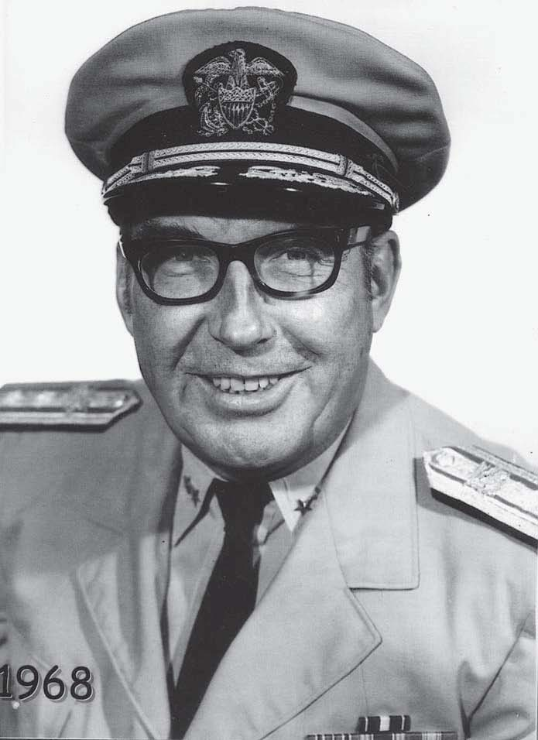
Honoring Dr. James H. Steele
Father of Veterinary Public Health
Assistant Surgeon General, U.S. Public Health Service
First met in 1999 at the AVMA Convention
Mentor and inspirer since first meeting in 1999
Visionary for integrating Veterinary Medicine with Human Medicine and Public Health

Slide 8
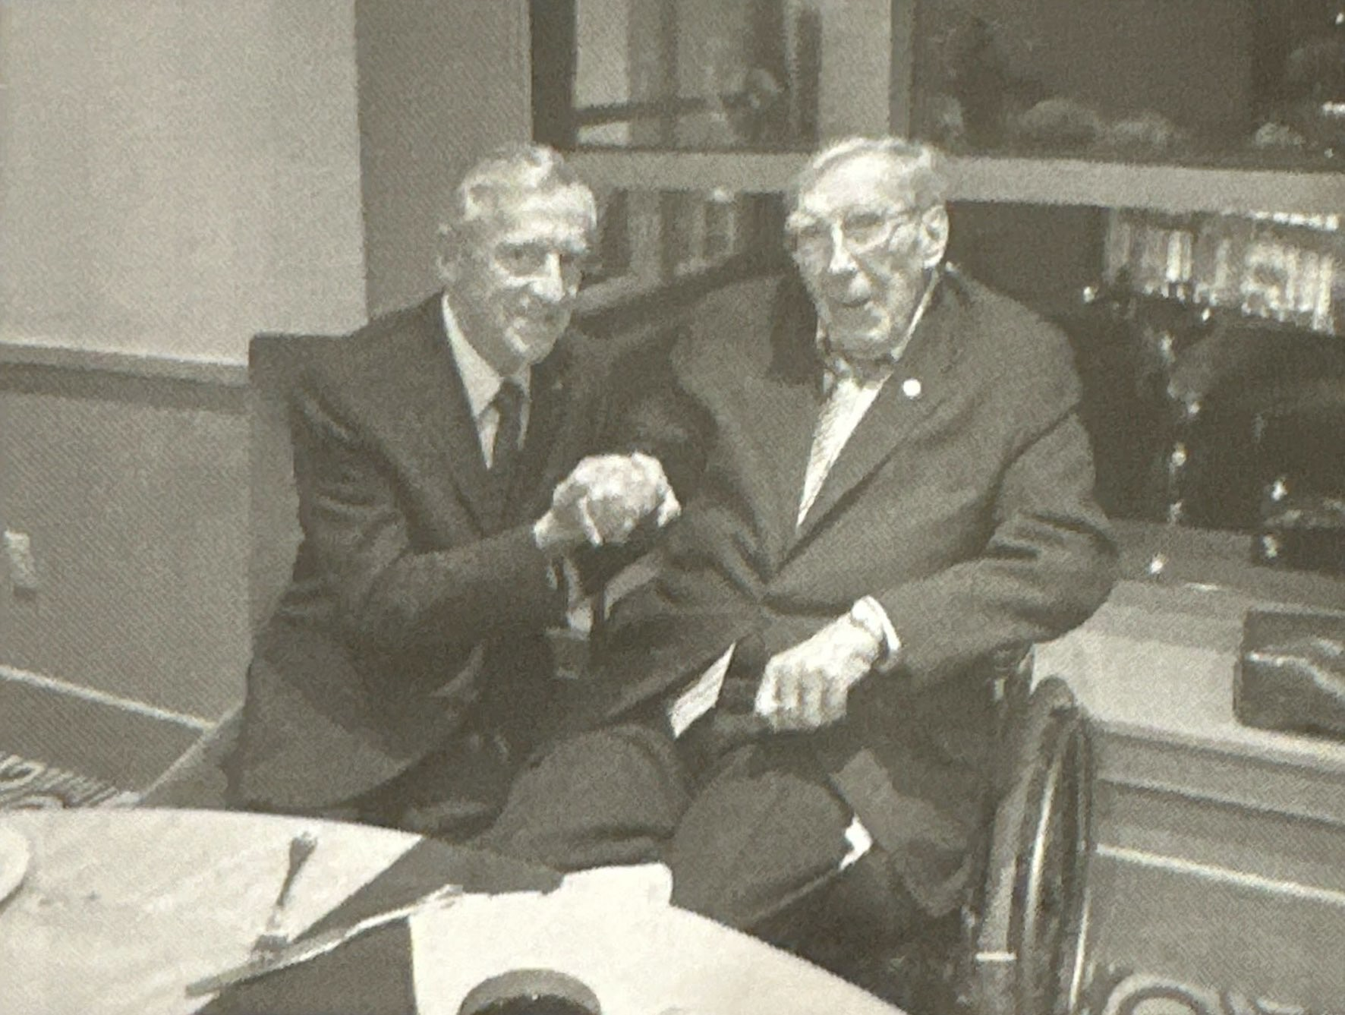
Honoring Dr. James H. Steele
Father of Veterinary Public Health
100th Birthday Celebration
April 3, 2013
Trevisio’s Restaurant
Houston, Texas
Dr. Mahr congratulates Dr. Steele on reaching 100 years

Slide 9
Value and Responsibility
Service
Professional service on behalf of animals and people
Serve profession through organized veterinary medicine
Commitment to volunteering in community service

Slide 10
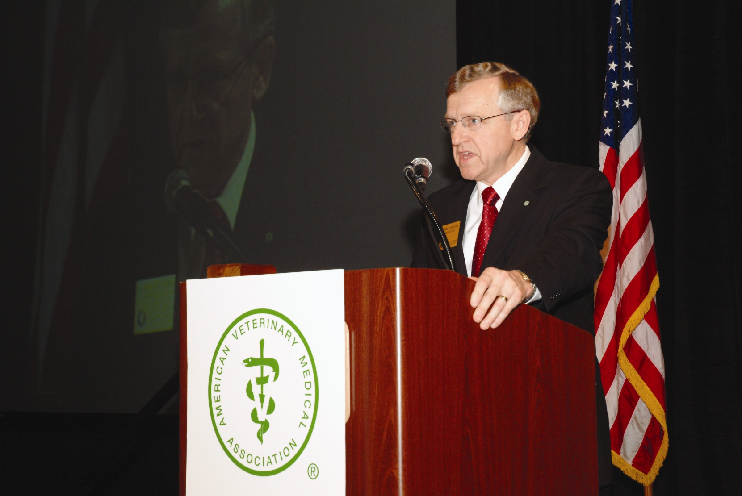
Value and Responsibility
Responsibility
Focal points for the AVMA Presidency:
AVMA Mission
“Improving Animal and Human Health,
Advancing the Veterinary Medical Profession”
National Academy of Sciences Study
“Animal Health at the Crossroads: Preventing, Detecting,
and Diagnosing Animal Diseases”
Recommendations from NAS Study:
Improving Communication, Coordination and Collaboration
Dr. Roger Mahr, July 2006

Slide 11
National Academy Study
One Health Challenges
Nearly 75% of all emerging infectious diseases in humans originate in animals
Environmental factors may affect human and animal health leading to new infectious agents
World population projected to over 9 billion by 2050
Ensuring a safe and available food and water supply for the growing global population
Beneficial impact of the human-animal bond on the health of both people and animals

Slide 12

Integrated Challenges and Integrated Solutions
Changing Environment
Vulnerable Humans
Carrier Animals

Slide 13
AVMA House of Delegates
President-Elect Address – July 14, 2006
Revealed Vision for One Health Initiative
Basis for Initiative:
Sense of Responsibility to the Future
Value to Society
Call for Collaborative Leadership
Dr. Roger Mahr, July 2006

Slide 14
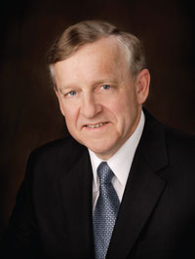
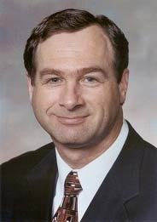
AVMA and AMA Collaborative Leadership
Dr. Roger Mahr
AVMA President 2006-2007
Dr. Ronald Davis
AMA President 2007-2008
“Shared collective vision for One Health around the world”

Slide 15
AVMA Executive Board Recommendation
April 2007
AVMA Executive Board approves the establishment of the One Health Initiative Task Force (OHITF)
Charge of the OHITF:
Defining ‘One Health’
Providing recommendations and strategic actions that would support and expand concept across health professions

Slide 16
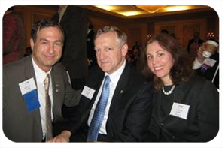
AMA House of Delegates Resolution
June 2007
Dr. Davis and Dr. Kahn draft AMA Resolution
AMA Resolution introduced supporting One Health
Dr. Mahr testifies before AMA House Reference Committee
Unanimously adopted by the AMA
Ronald Davis, MD Roger Mahr, DVM Laura Kahn, MD
AMA and AVMA to engage in dialogue towards enhancing collaboration

Slide 17
2007 AVMA Convention — Washington, D.C.
Building Momentum In Collaboration
CDC Director Dr. Julie Gerberding gave the Convention keynote address
“One Medicine: Fly Under One Flag” joint AVMA–AMA session
  Joint press conference with AMA President Dr. Ronald Davis
  Pan American Health Organization joined the dialogue
Biography of Dr. James H. Steele

Slide 18

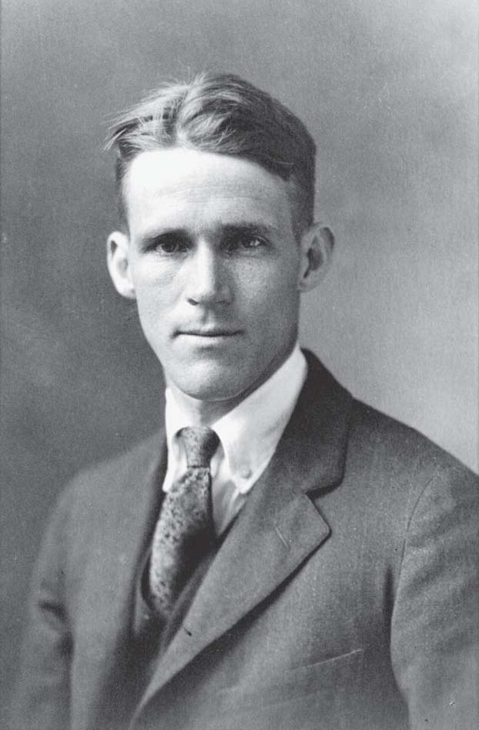
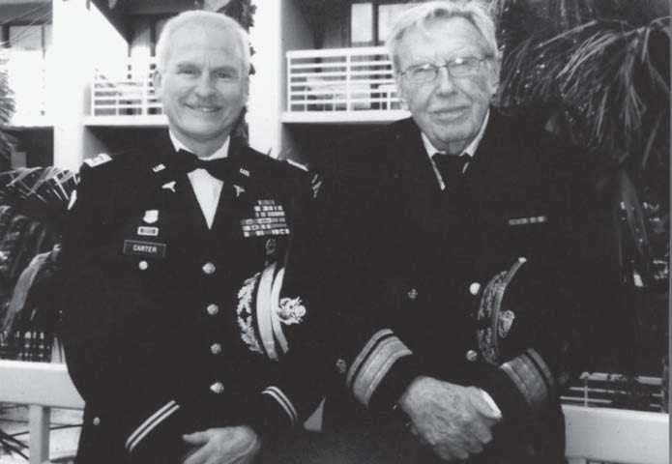
AVMA and AMA Joint Session
One Medicine: Fly Under One Flag
Dr. Cecil Drinker
Dr. Craig Carter Dr. James Steele
“Dedicate your career to public health under your own colors as a Veterinarian, not under two flags as an MD and DVM.”
- Dr Cecil Drinker, Dean of School of Public Health Harvard, James H. Steele Mentor

Slide 19
One Health Initiative Task Force
Commitment
Visionary
Communication
Collaboration

Slide 20

One Health Initiative Task Force
Final Report – July 15, 2008
Dr. Lonnie King served as Chair of the OHITF.
Task Force presented final report to the AVMA Executive Board in June 2008.
Established the vision and recommendations for One Health.

Slide 21
One Health Joint Steering Committee
Independent Multidisciplinary
Facilitate Transitioning Process
Rockefeller Foundation Grant Support
USDA, CDC, and NIEHS Support
Establish One Health Commission

Slide 22
One Health Commission
Chartered in Washington D.C. – June 29, 2009
‘Request for Proposal' to secure leading partner
Iowa State University and ISU-led One Health Consortium
MOU Established – January 31, 2011
Headquarters at ISU Research Park
Joint One Health Strategic Plan
Dr. Cheryl Stroud selected as Executive Director in January 2014
Current Headquarters in Apex, North Carolina
www.onehealthcommission.org

Slide 23
One Health Initiative Autonomous pro bono Team
Autonomous pro bono Team has championed the One Health movement since its inception.
Co-founded by Bruce Kaplan DVM, Dr. Laura Kahn MD, and Dr. Tom Monath MD.
Built a global information hub educating and connecting the One Health community.
Advanced global collaboration through two decades of leadership, partnerships, and advocacy.
www.onehealthinitiative.com

Slide 24
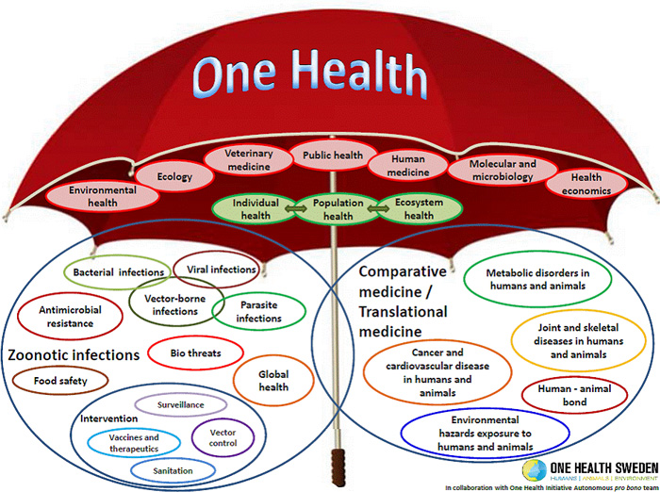
Scope of One Health
Looking to the Future
Health challenges are becoming more disruptive and complex
Education and workforce are the focal point of our responsibility
COVID-19 demonstrated how challenging a global One Health scenario can be.
Reinforces need for local-to-global One Health coordination, communication, and collaboration.

Slide 25
Scope of One Health
Collaborative Leadership
Human Health
Animal Health
Environmental Health
Other Related Disciplines

Slide 26
Collaborative Responsibility
Our Value
Our Responsibility
Renew our commitment to assume our collaborative responsibility & to protect and promote our immeasurable value

Slide 27

ONE HEALTH
World Health Through Collaboration
“CARRY ON”
Dr. James H. Steele
Father of Veterinary Public Health

Slide 28
By working together with new and enhanced collaborative leadership, we can convert our 21st century challenges into opportunities.
“Carry On!”
— James H. Steele, Father of Veterinary Public Health
World Health Through Collaboration
ONE HEALTH

